Slide 1
-League Of Legends- Factors that Improve my gamIng performance
Kağan Ali Korkmaz
30637

Slide 2


My Data Set

Slide 3
Op.GG and rıot Apı
The Riot API provided access only to real-time data. Therefore, I needed to find a platform that stored historical data and extract the necessary information from there.
For this purpose, I collected relevant data from the OP.GG website, including past match records, match summaries, and champion details.

Slide 4
Data Retrieved
Match date
Match results (Kills/Deaths/Assists)
Average CS (Creep Score) per match
Average CS (Creep Score) per match
Total wins and losses
Champion picks (season-based)
Number of matches played with each champion
Wins and losses with each champion
Win rate with each champion
K/D/A per champion

Slide 5

Hypothesis
KDA and champion selection affect my gaming performance
My gaming frequency has an impact on my overall performance.

Slide 6
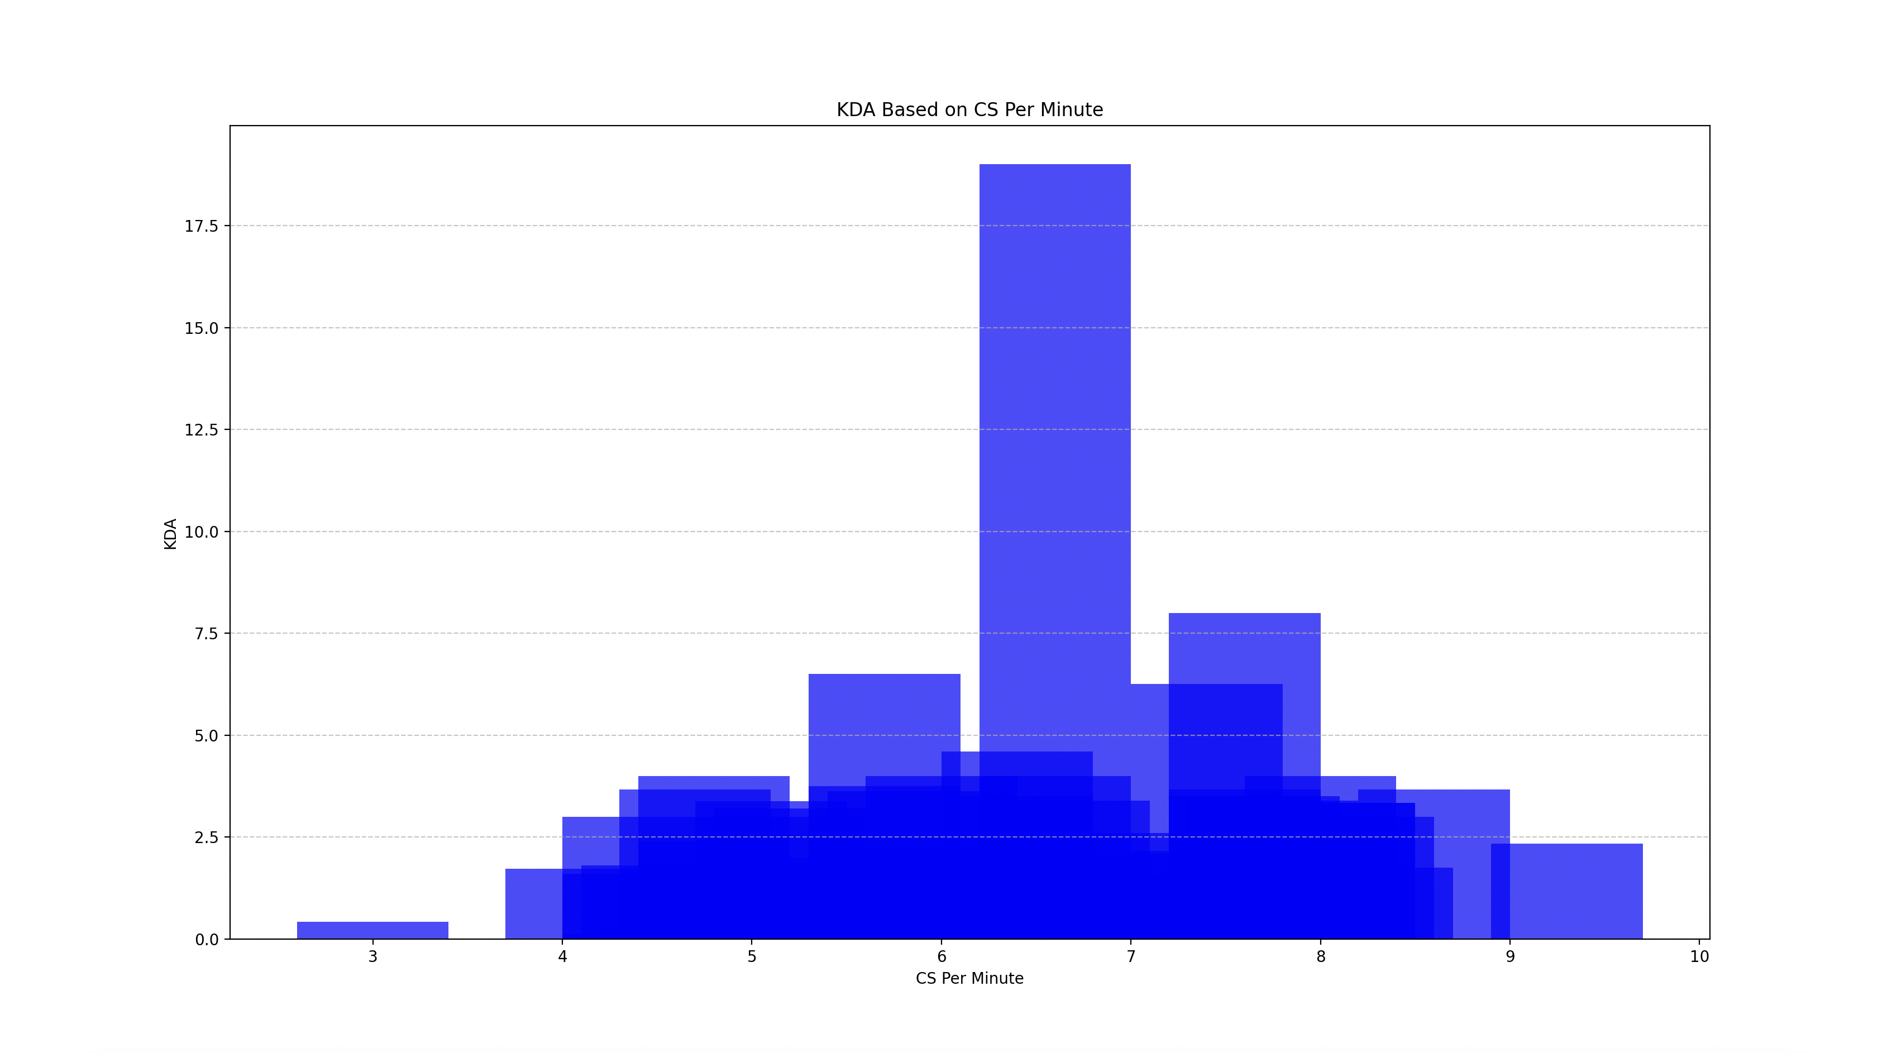
KDA Based On CS Per Mınute
First, I analyzed the factors affecting my KDA and examine how my CS per minute score impacts my KDA performance.
The right side of the chart shows a noticeable increase, indicating that my CSPM value has a positive effect on my KDA.

Slide 7
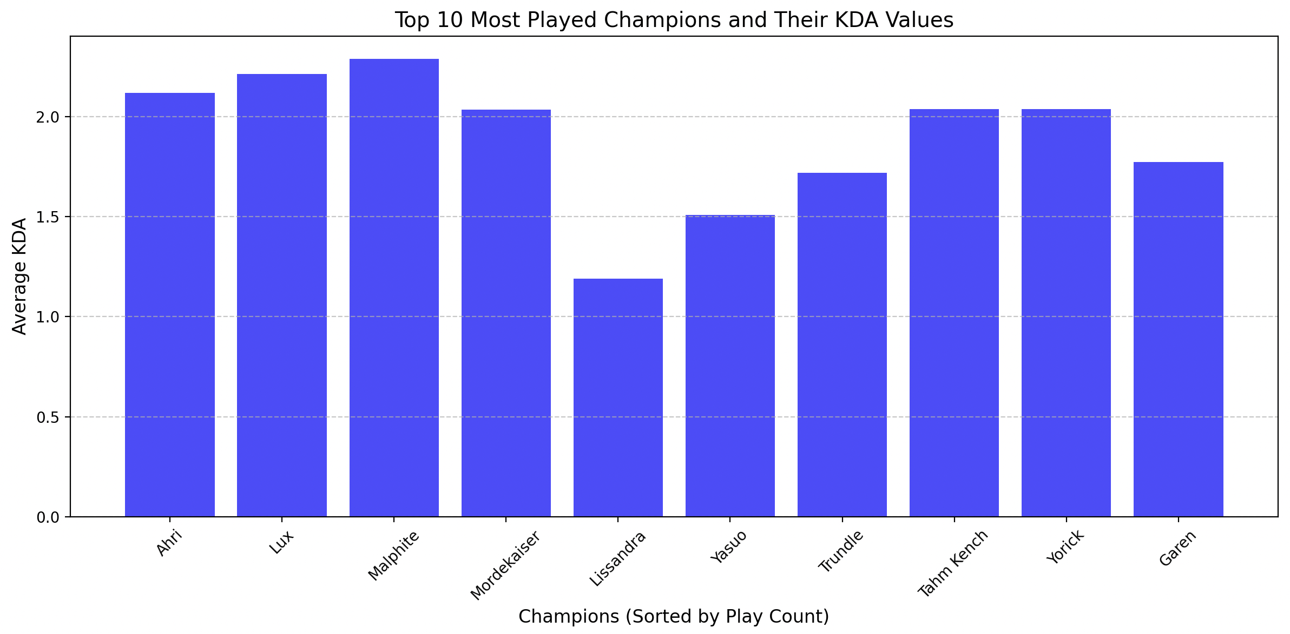
Top 10 Most Played champions and Their K/d/a
Here, I analyzed my top 10 most-played champions to explore the relationship between the frequency of playing a champion and its corresponding KDA value.
It appears that there is no observable effect of playing a champion more frequently on the associated KDA value.

Slide 8
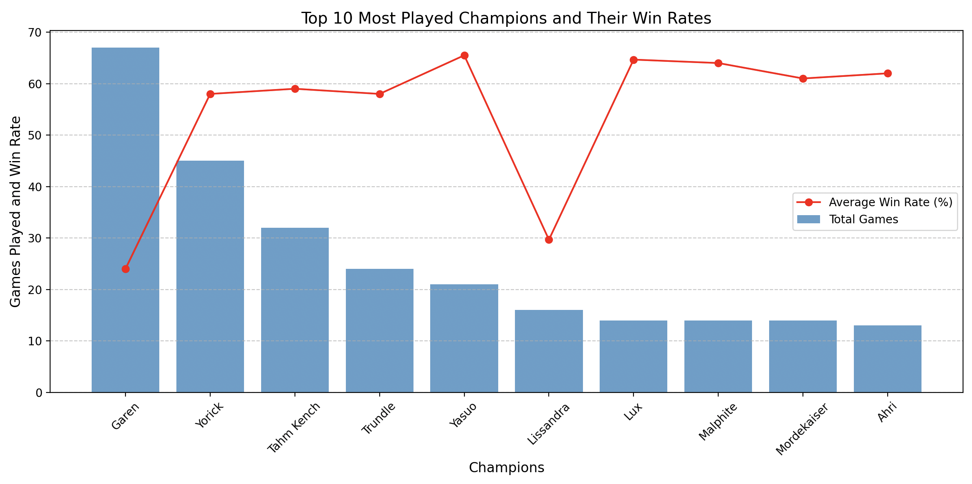
Top 10 Most Played Champıons and theır wın rates
Here, I analyzed the effect of my play frequency with a champion on its win rate.
It appears that the frequency of playing a champion does not have a significant impact on my win rate.

Slide 9
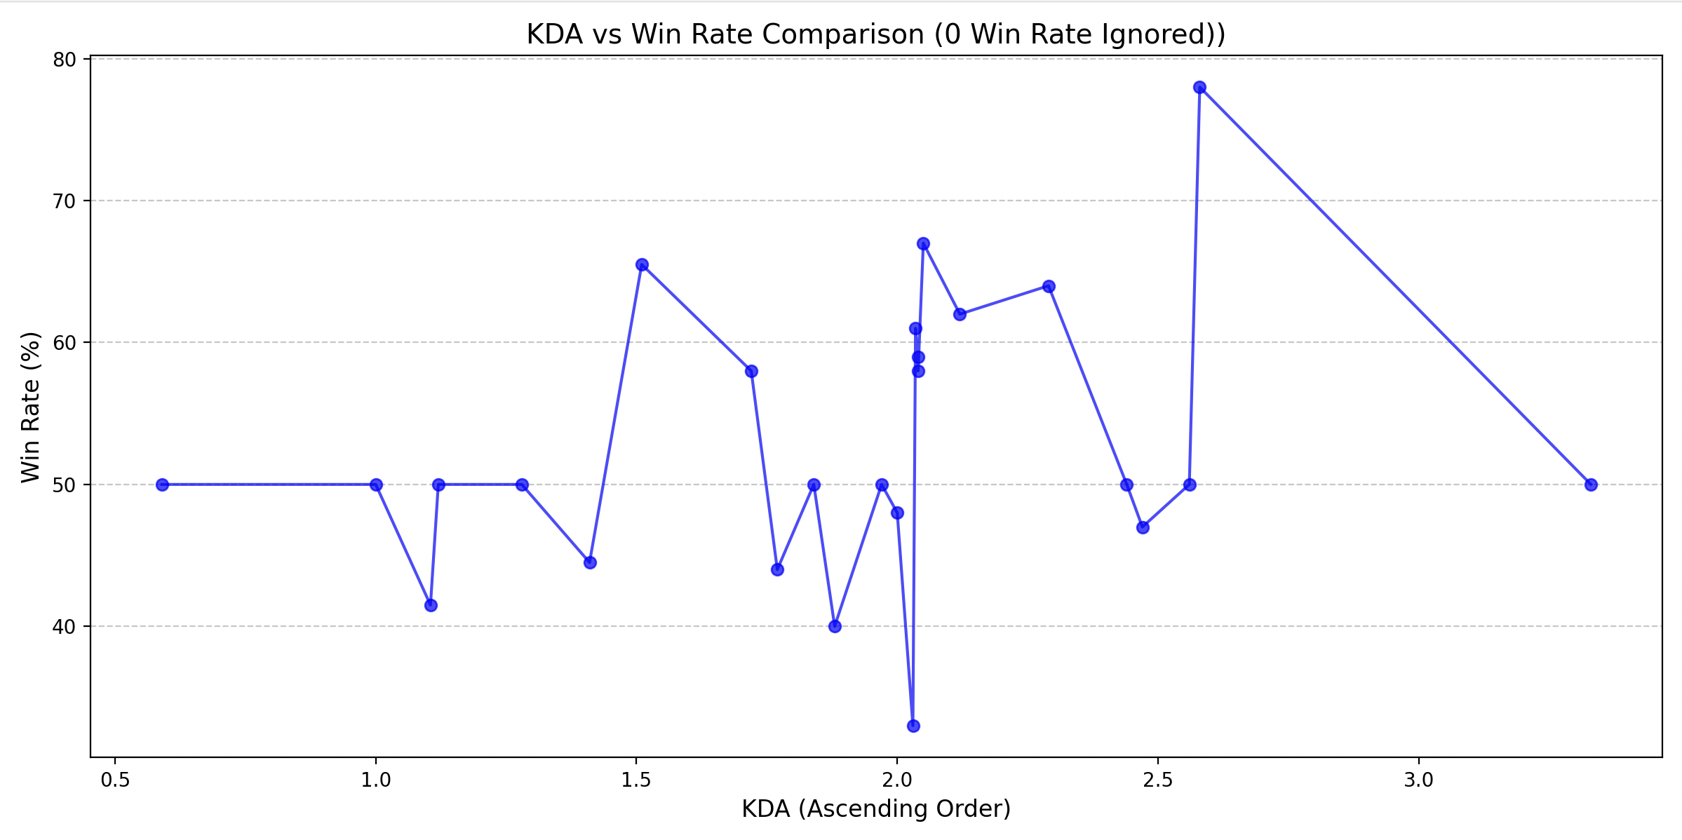
Kda vs wın rate comparıson
I am analyzing whether there is a relationship between KDA values and win rates.
When examining win rates above a KDA value of 2.0, we can observe that they are mostly above 50%.
This suggests that higher KDA values have a positive impact on win rates.

Slide 10
By now
We found that the KDA value is minimally influenced by the CS per minute value.
However, we observed that the KDA value positively impacts the win rate.
Now, we will analyze how my periodic gaming frequency affects certain parameters, and indirectly, my overall gaming performance

Slide 11
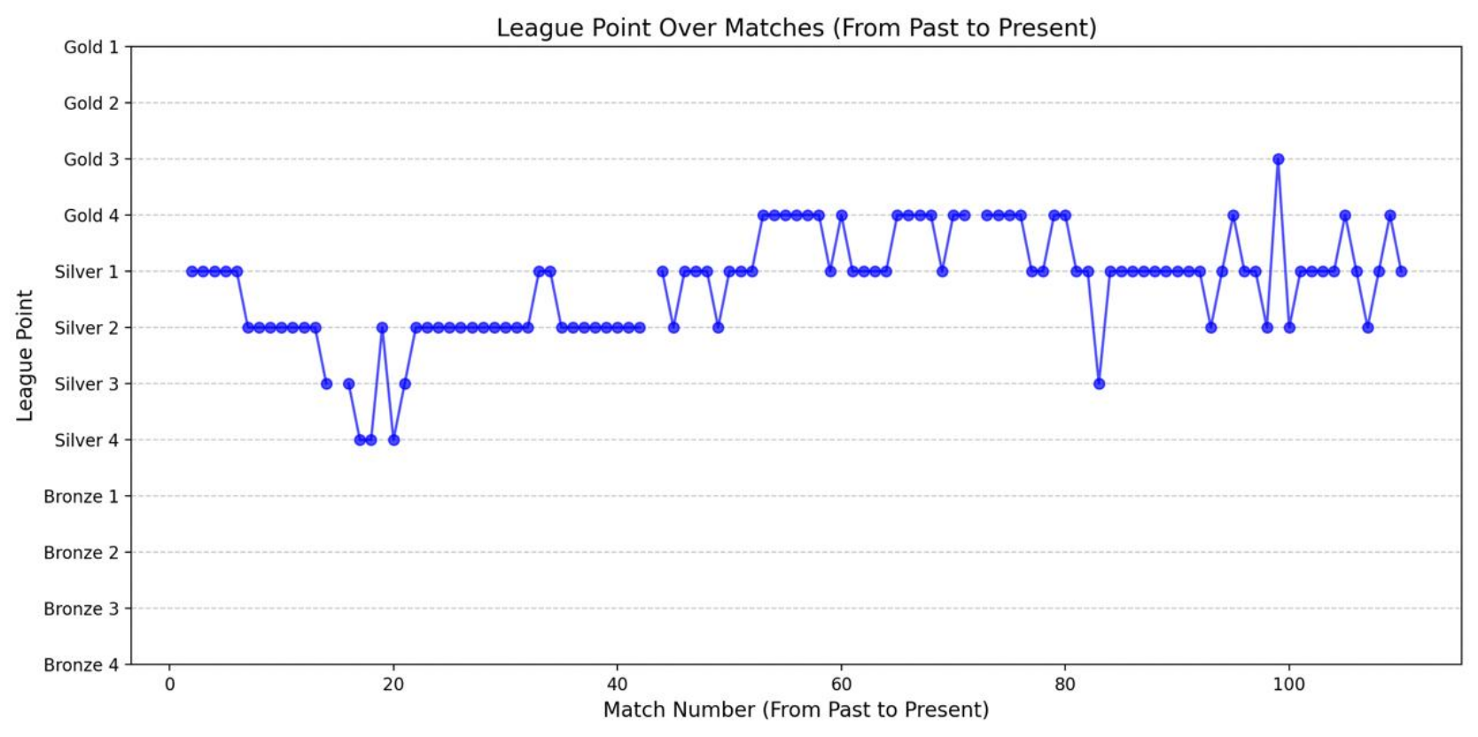
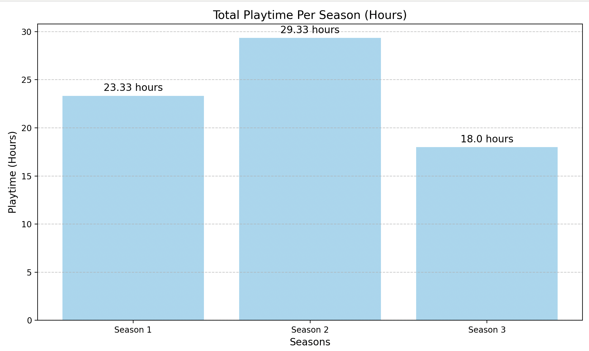
League Poınt over matches
The periods when I played the most frequently are Season 2 and 1. Looking at the increase in LP points over time, it can be seen that my most successful period aligns with matches between 20 and 80.
This corresponds to Seasons 1 and 2, indicating that the more consistently I play, the steadier my improvement.
However, as seen in Season 3 and the right-hand graph, after 80 matches, there is no clear stability, meaning that playing less frequently does not guarantee a successful gaming period.

Slide 12
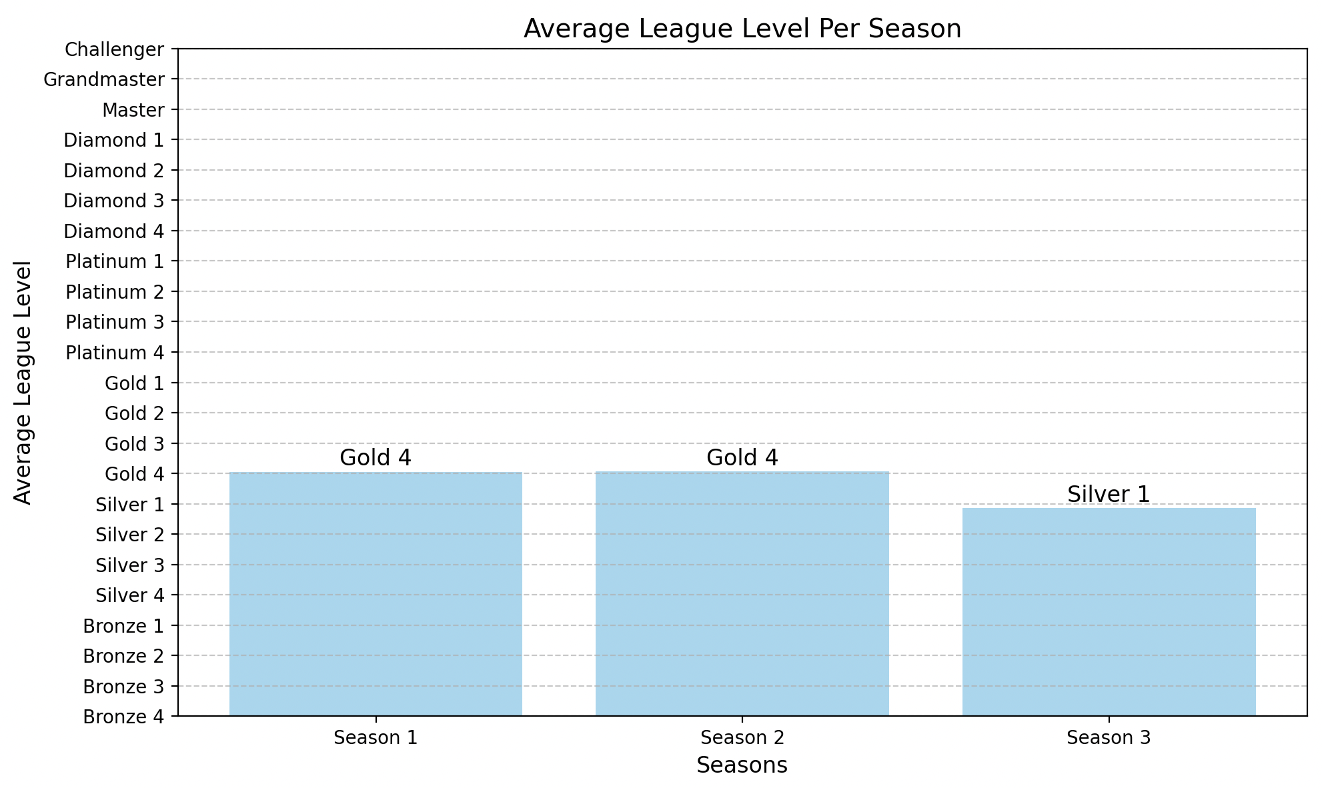
Average League Level Per Season
Following our previous conclusions, we now examine this graph, which shows my average league level per season.
My most successful periods are Seasons 1 and 2. This indicates that the more frequently and consistently I play, the more successful I become.

Slide 13
In Conclusıon
Based on the analysis conducted throughout this project, I can draw several conclusions about my hypotheses. First, it is evident that champion selection does not significantly influence my win rate. However, the KDA value does have a positive and measurable impact on my win rate, confirming the hypothesis that better in-game performance correlates with higher success. Additionally, the frequency of playing has a noticeable effect on my likelihood of achieving success. Seasons where I played more consistently, such as Season 1 and Season 2, showed higher league levels and better performance, supporting the idea that consistent practice contributes to improvement. Overall, while some factors like champion choice appear negligible, others like KDA and play frequency have meaningful effects on my gaming performance.

